Slide 1


Newton's Second Law
Studying the behavior of a propelled car

Slide 2

^{Newton's Second Law}
Studying the behavior of a propelled car
^{Introduction and theory}
Force is a concept commonly used in everyday life. Some people compete to see who is stronger, but perhaps they don’t fully understand the concept of force.
Force corresponds to a measure of interaction between bodies. There are many types of strength, such as electromagnetic forces or gravity, but all these types of force correspond to the second law of Newton.
What equipment or machinery require the application of force in order to work?

Slide 3

^{Newton's Second Law}
Studying the behavior of a propelled car
^{Objective}
The objective of this research is to study the variation of force and acceleration of a car when propelled with different hanging masses. A hypothesis will be formulated and verified using the Dymo force sensor.

Slide 4
^{Newton's Second Law}
Studying the behavior of a propelled car
^{Introduction and theory}
What happens when a force is applied to an object?
What should happen to say that we are in presence of a force?

Slide 5

^{Newton's Second Law}
Studying the behavior of a propelled car
^{Introduction and theory}
^{Theoretical}
To understand Newton's second law, we must first understand some basic concepts. For example, what is meant by acceleration and force?
Acceleration corresponds to a vector quantity, i.e., that has magnitude and direction (unlike scalar, possessing only magnitude). Its value corresponds to the rate of change of velocity, or speed variation over time.
The strength also corresponds to a vector quantity and a measure of interaction between bodies. To better understand these concepts, define laws that explain motion.

Slide 6
^{Newton's Second Law}
Studying the behavior of a propelled car
^{Introduction and theory}
Three of Newton laws or principles are the starting point for classical mechanics. The first law of Newton corresponds to a so called "Law of Inertia". It tells us that a body where the net force applied on it is zero, will not bring any change in speed.
Now, when the net force is not zero, Newton's second law gives us information about an inherent property of bodies that is the mass. This scalar magnitude indicates the resistance of a body when it changes its speed, and corresponds to the constant in the direct proportionality of the net force with acceleration.

Slide 7
^{Newton's Second Law}
Studying the behavior of a propelled car
^{Introduction and theory}
Newton's third law tells us that there is always a reaction when an additional force is applied in the opposite direction to the applied force. This reaction occurs in different bodies. For example, if I push a box with some force, the box performs the same force on me but in the opposite direction. This is symbolized if there are two objects 1 and 2, the force applied from the object 1 to the object 2 will be identical to the force applied by object 2 on item 1, but in the opposite direction.

Slide 8
^{Newton's Second Law}
Studying the behavior of a propelled car
^{Introduction and theory}
Throughout our lives we commonly interact with many forces such as weight force. In physics, the distinction between strength, weight and mass is very important in explaining the behavior of objects. Body mass, as mentioned above, corresponds to an inherent property of bodies, whereas weight corresponds to a measure of interaction between the planet and a body on its surface. It is well known that if you're in space you are weightless, but that does not mean you have lost your mass. The equation for calculating the weight of an object corresponds to:
Where is the acceleration of gravity on Earth and is considered constant with a value of . Acceleration can be measured in multiples of the value g.

Slide 9
^{Newton's Second Law}
Studying the behavior of a propelled car
^{Introduction and theory}
Now students are encouraged to raise a hypothesis which must be tested with an experiment.
If a car on a horizontal surface connected by a pulley is propelled by a product of weight of a hanging mass, how does force and acceleration behave if it stops suddenly? What happens to the values of force and acceleration if the weight with which it is propelled is increased.

Slide 10
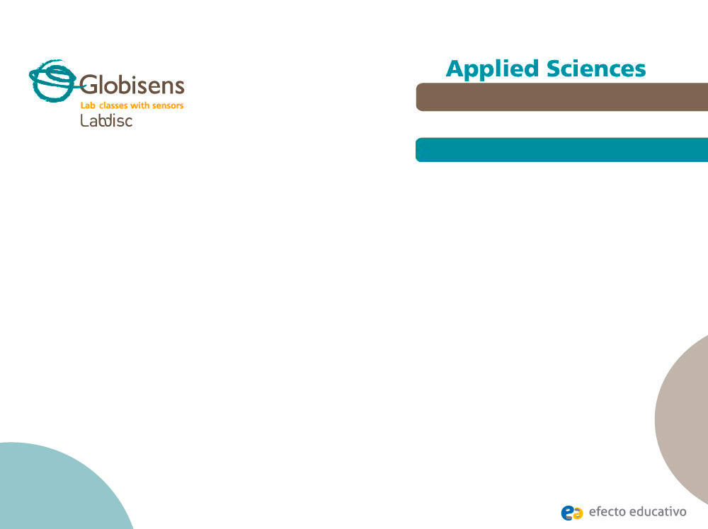
^{Newton's Second Law}
Studying the behavior of a propelled car
^{Activity description}
Students will measure the force and acceleration of a cart propelled by three hanging masses of 50, 80 and 100 grams.

Slide 11
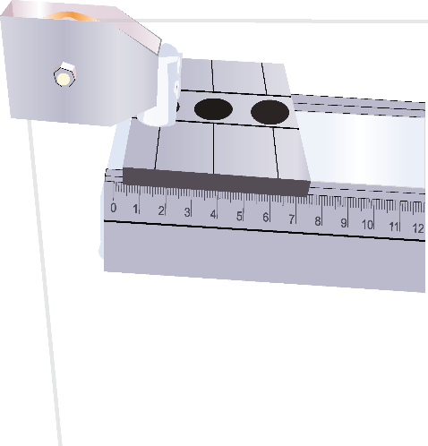
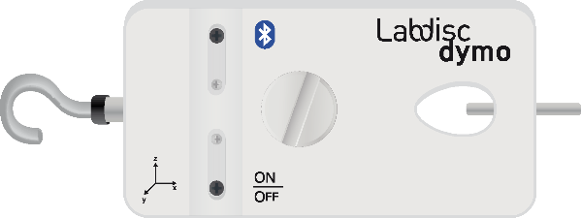
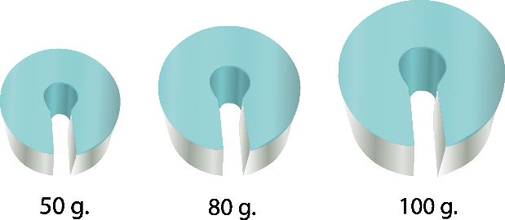
^{Newton's Second Law}
Studying the behavior of a propelled car
^{Resources and materials}
Dymo Labdisc force sensor
Pulley
Weights of 50, 80 and 100 grams
Shock absorber
Rail
Cart
String

Slide 12
^{Newton's Second Law}
Studying the behavior of a propelled car
^{Using the Labdisc}
^{Configuring the Labdisc}
To collect force measurements with the Dymo Labdisc force sensor, follow these steps:
Open the GlobiLab software and turn on the Labdisc
Click the Bluetooth button in the bottom right of the GlobiLab screen. Once the Labdisc has been recognized by the software, the icon will change from gray to blue.
(In this experiment it is not preferable to use the USB connection)
1
2

Slide 13
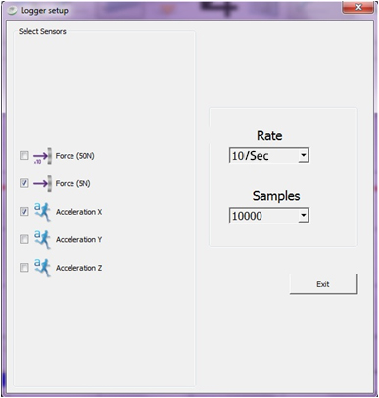
^{Newton's Second Law}
Studying the behavior of a propelled car
^{Using the Labdisc}
Click (*) to setup the Labdisc. Select “Force (5N)” and "acceleration X" in the window "Logger Setup”. Enter "10/sec" in rate and 10000 samples.

Slide 14


^{Newton's Second Law}
Studying the behavior of a propelled car
^{Using the Labdisc}
4
Once the sensor configuration is finished, click on to start measuring
Once you have finished measuring stop the Labdisc by clicking
5

Slide 15
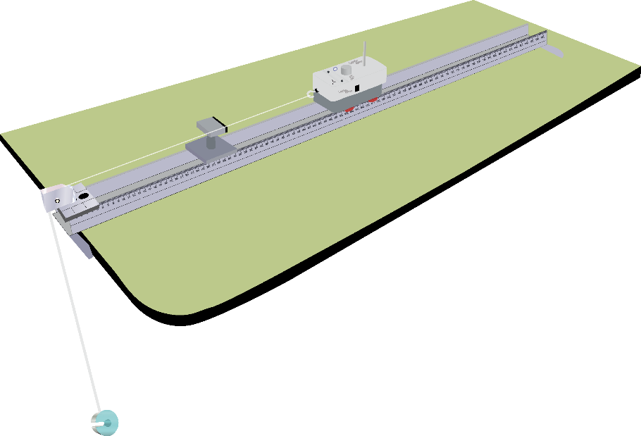
^{Newton's Second Law}
Studying the behavior of a propelled car
^{Experiment}
Install the rail, pulley, and shock absorber.
Post the Labdisc Dymo force sensor over the cart so that the hook points in the direction of the pulley.
Connect the Labdisc by string to the hanging mass of 50 grams, passing the rope through the pulley.

Slide 16
^{Newton's Second Law}
Studying the behavior of a propelled car
^{Experiment}
Start taking measurements, stopping after the collision between the shock absorber and the car occurs.
Repeat the procedure for each of the masses.

Slide 17



^{Newton's Second Law}
Studying the behavior of a propelled car
^{Results and analysis}
Observe each of the curves by clicking Force (5N) or acceleration
as appropriate.
After this, show the values of force and maximum acceleration of each graph by clicking on the curve with the tool (*) .

Slide 18

^{Newton's Second Law}
Studying the behavior of a propelled car
^{Results and analysis}
By observing each graph, where are the maximum and minimum values of the net force and acceleration presented? Is there a recurrence?
How much is the maximum acceleration in each case (using the international system of measurement)?
Comparing the graphs’ acceleration and force, what similarities can you find?

Slide 19
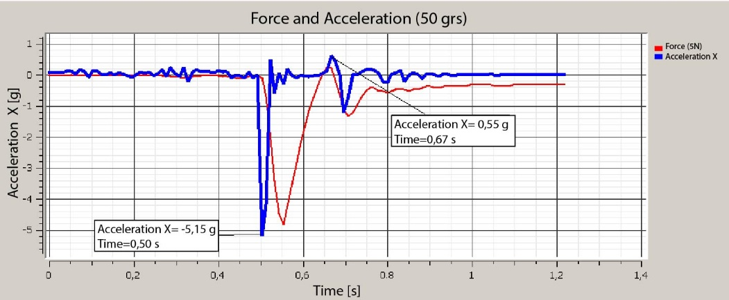
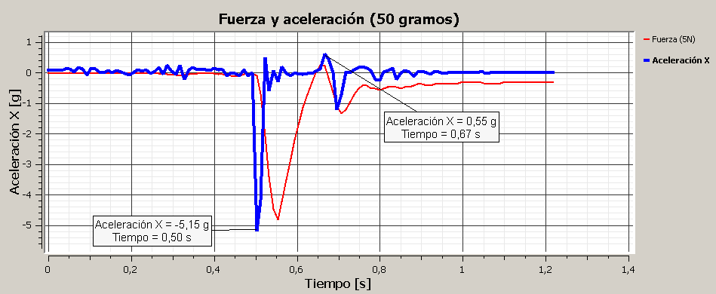
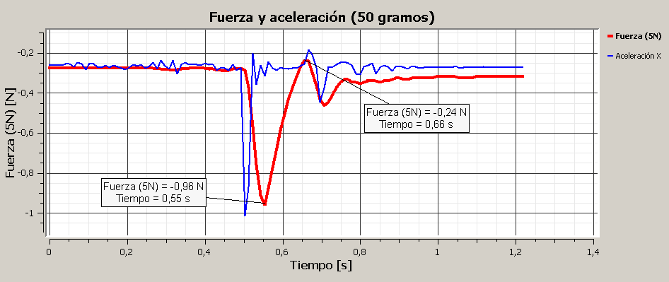
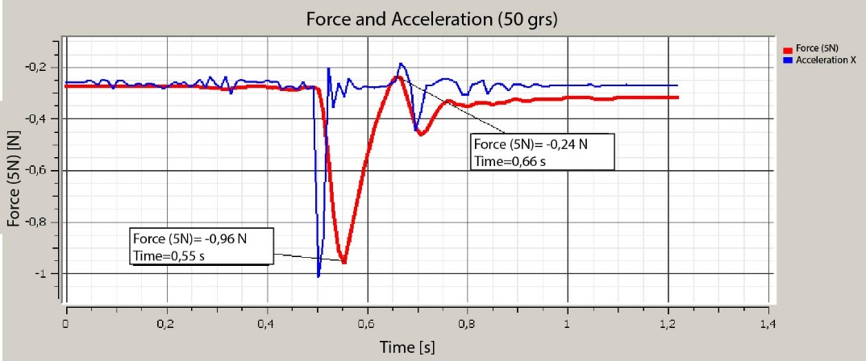
^{Newton's Second Law}
Studying the behavior of a propelled car
^{Results and analysis}
The graph below should be similar to the one the students came up with:

Slide 20
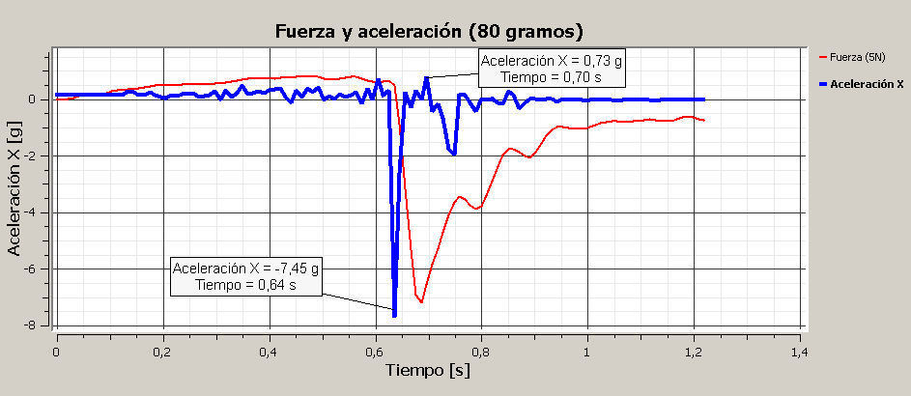

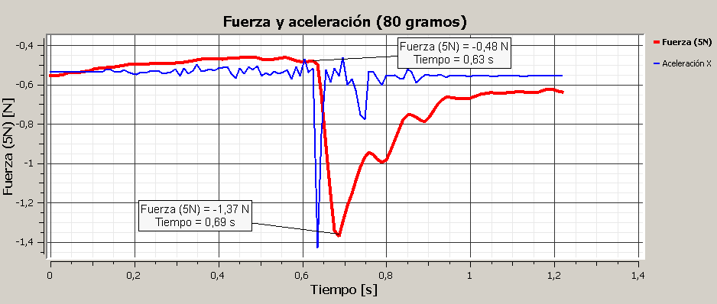
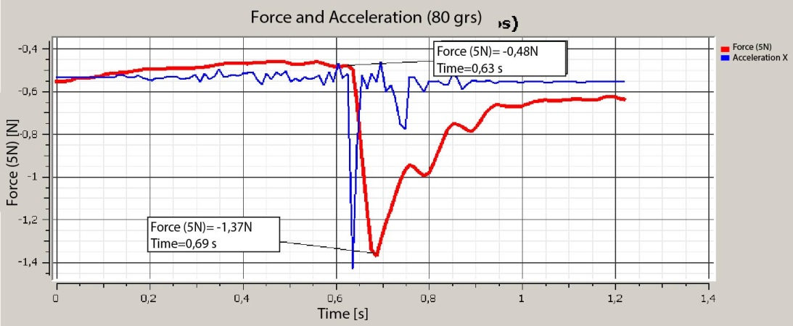
^{Newton's Second Law}
Studying the behavior of a propelled car
^{Results and analysis}
The graph below should be similar to the one the students came up with:

Slide 21
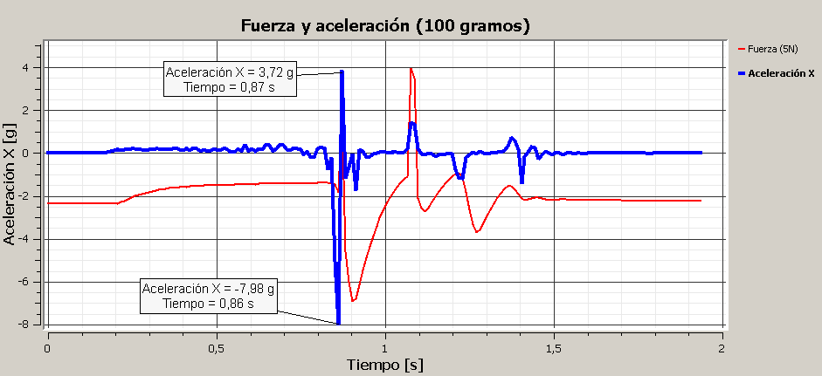
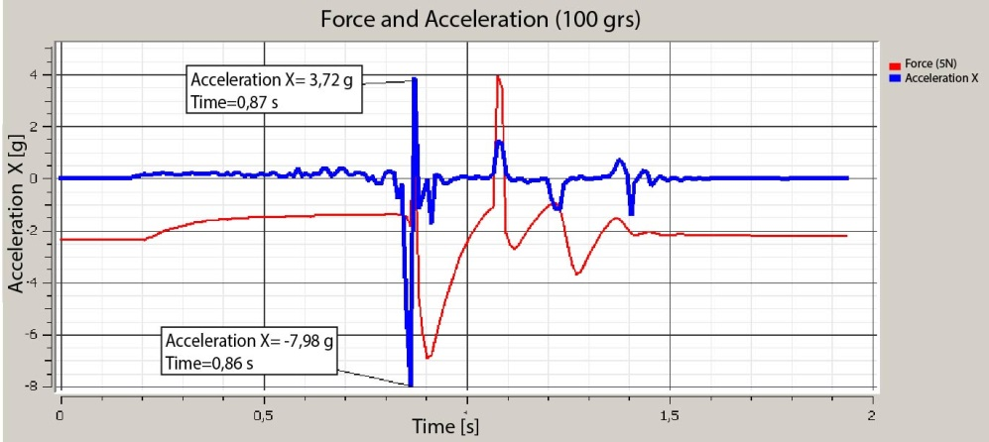
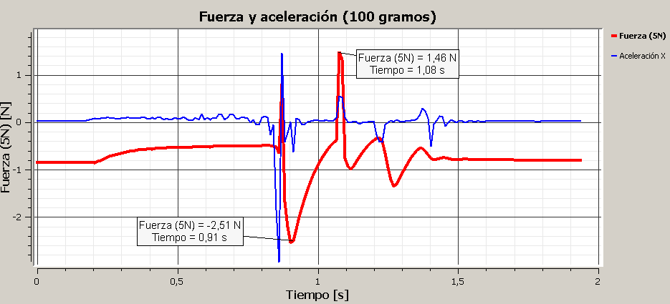
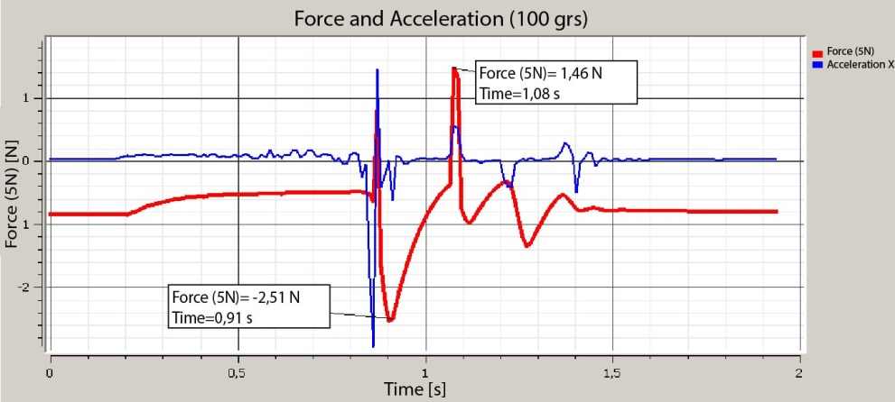
^{Newton's Second Law}
Studying the behavior of a propelled car
^{Results and analysis}
The graph below should be similar to the one the students came up with:

Slide 22

^{Newton's Second Law}
Studying the behavior of a propelled car
^{Conclusion}
Which graph’s results presents greater acceleration and higher net force? What factor do you attribute this to?
Students should identify the graph with most acceleration and force as the one where a mass of 100 grams was used. They attribute this to the fact that the higher the hanging mass, the greater the net force that propels the cart, because the weight force increases.
When the cart is in motion, Why is a lower acceleration presented, almost negligible, with respect to the acceleration experienced when braking?
Students must identify the change in velocity experienced by the cart to slowing down and losing all speed comes at a small time interval compared to the time it took to acquire it, so the acceleration is greater.

Slide 23
^{Newton's Second Law}
Studying the behavior of a propelled car
^{Conclusion}
What reason do you attribute the similarities of the graphics of acceleration and net force?
Students should identify that the net force applied to the cart and acceleration magnitudes are related. When in motion and one changes, the other will too because of the Newton’s second law.
When the cart stops completely, why does the sensor measure some force if
no movement occurs?
Students must identify that while the net force is proportional to acceleration, the sensor is then measuring the cord tension. This force does not correspond to the total force.

Slide 24
^{Newton's Second Law}
Studying the behavior of a propelled car
Activities for further application
When does a car engine perform at greater power? At the beginning of the movement or when it is in constant speed? Justify
Having learnt Newton’s second law, the students should identify the acceleration which determines the net force. Therefore, it must be non-zero at the beginning of the movement, and equal to zero when the velocity is constant. In this way the motor performs with greater force to start the motion. Students can present the idea that the engine should not apply strength when the car is in constant motion, erroneously considering this force as the total force.
What would happen to the results if instead of increasing the hanging mass, the mass of the cart is increased?
Having learnt Newton's second law, students must interpret that by increasing the mass of the cart acceleration is decreased, since the net force does not vary in each case.

Slide 25


